Slide 1


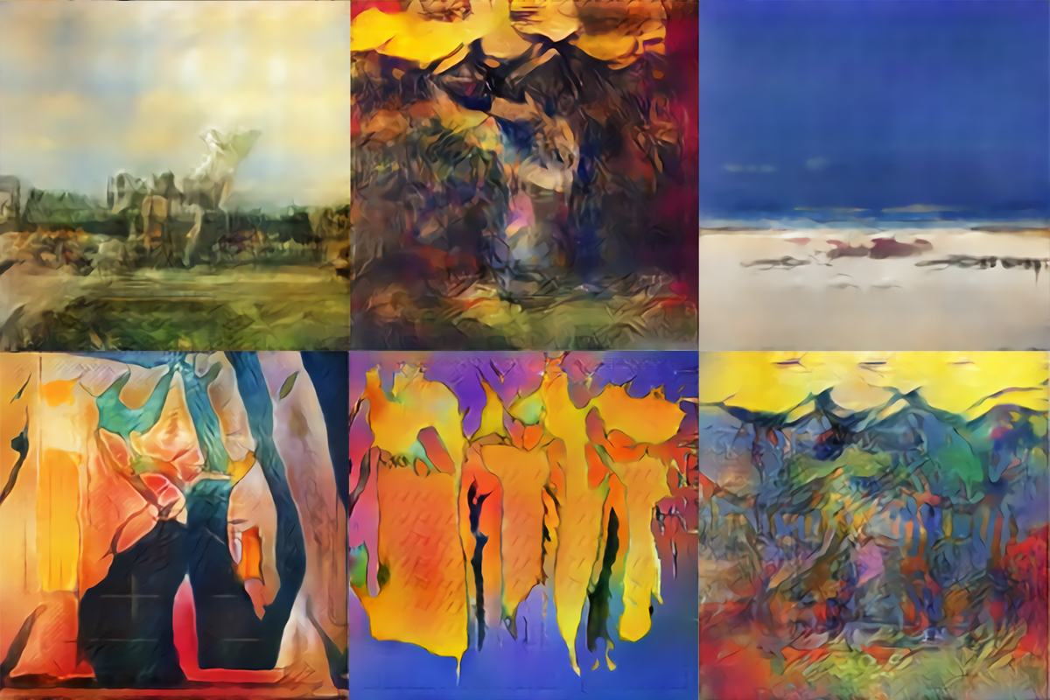
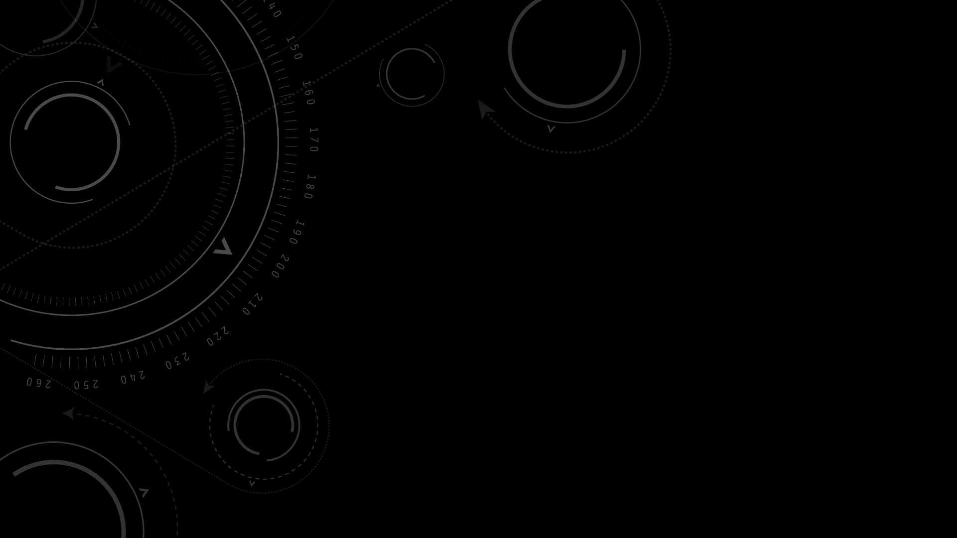
Generative adversarial Networks (GAN)
Ian J. Goodfellow, Jean Pouget-Abadie, Mehdi Mirza, Bing Xu, David Warde-Farley, Sherjil Ozair, Aaron Courville, Yoshua Bengio
Presented by Zayid oyelami

Slide 2

1 - Introduction

Slide 3

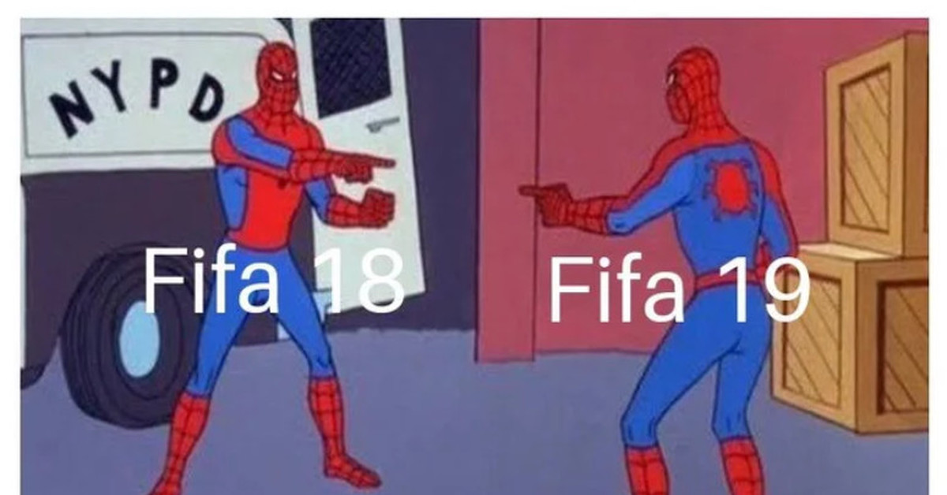


Slide 4

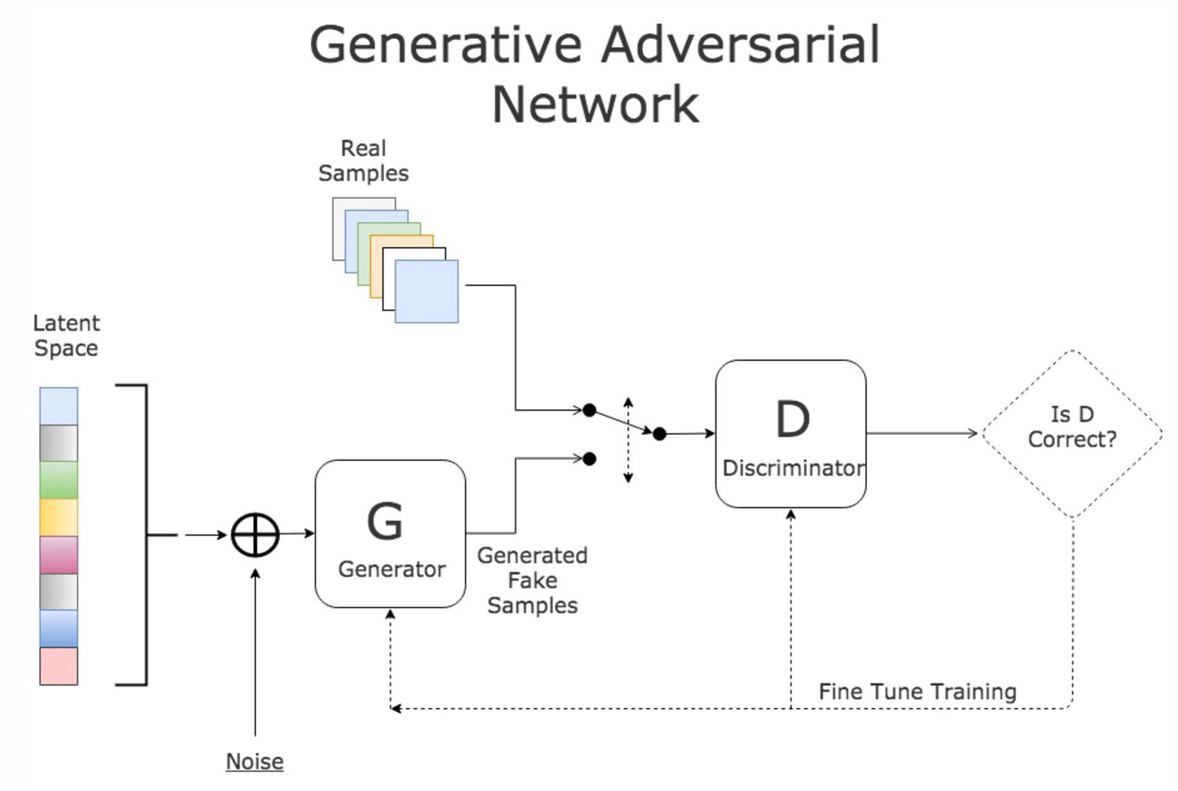
framework
MARVEL
VS
DC
GENERATIVE MODEL
VS
DISCRIMINATIVE MODEL

Slide 5
x sampled from data
Differentiable function, D
D(x) tries to be near 1
Input noise, z
Differentiable function G
X sampled from model
D
D tries to make D(G(z)) near 0,
G tries to make D(G(z)) near 1

Slide 6
2 - Related work

Slide 7
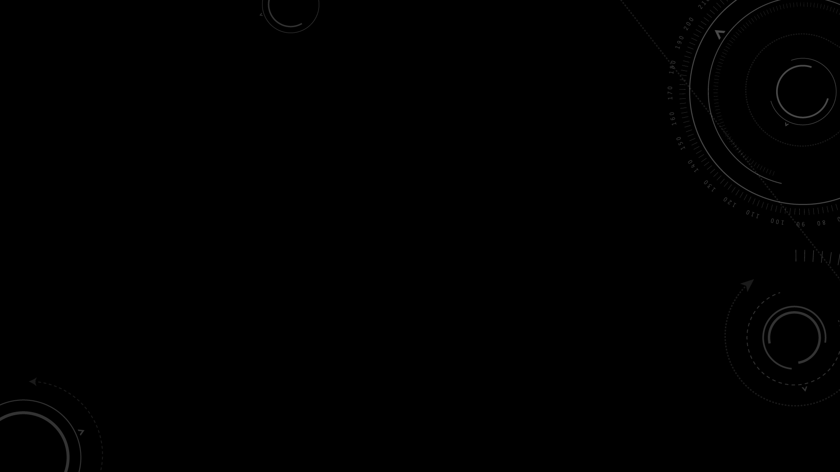
Explicit density models: Model our data directly from a probability distribution. We explicitly define the probability and solve for it
Implicit density models: Learn to sample from a probability distribution without defining what that distribution is

Slide 8
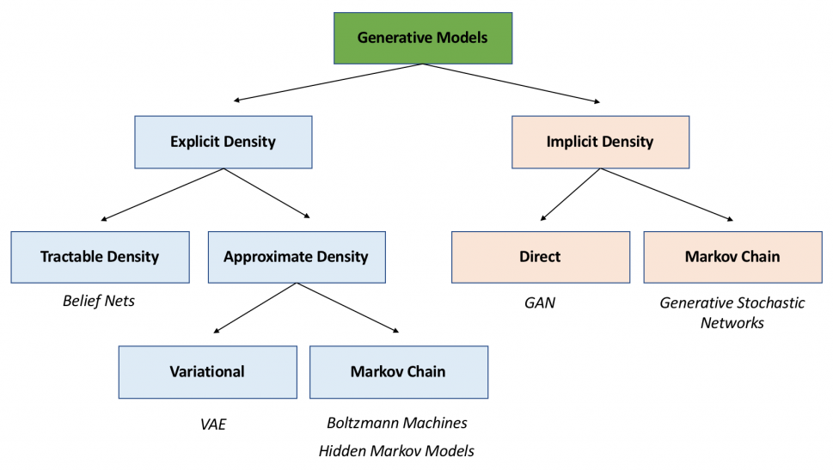
Notes:
Tractable: is related to defined computational time; we can calculate the computational complexity of a tractable problem
Approximate density: relates to intractability—a computer science term that means that there is no defined computational time or algorithm. In practice, an intractable problem utilizes too many computational resources in order to be useful. Therefore, approximate density models use probabilistic approximation techniques to estimate the solution.
Markov chains: Simply put, a Markov process is a sequence of events where the probability of an event happening solely depends on the previous event.
Boltzmann machines: general class of models that contain take binary vectors as input and units that assign a probability distribution to each of those binary vectors. A Boltzmann machine uses something called an energy function, which is similar to a loss function. For any given vector, the probability of a particular state is proportional to each of the energy function values. To convert this to an actual probability distribution, it's necessary to renormalize the distribution, but this problem becomes another intractable problem. Monte Carlo methods are again used here for sampling as a workaround, hence making Boltzmann machines a Monte Carlo-based method.
Monte-Carlo: Produces best solution with a certain probability by using the process of repeated random sampling to make numerical estimations of unknown parameters.

Slide 9
Mentioned Methods I
Deep Boltzmann Machine: from a family of models that provided a parametric speciﬁcation of a probability distribution function, then can be trained by maximizing the log likelihood
Generative Stochastic Networks: a generative machine that can be trained with exact backpropagation rather than the numerous approximations required for Boltzmann machines. This work extends the idea of a generative machine by eliminating the Markov chains used in generative stochastic networks.
Variational Autoencoders : pair a differentiable generator network with a second neural network. Unlike generative adversarial networks, the second network in a VAE is a recognition model that performs approximate inference.
GANs require differentiation through the visible units, and thus cannot model discrete data, while VAEs require differentiation through the hidden units, and thus cannot have discrete latent variables

Slide 10
Mentioned Methods II
Noise-Contrastive Estimation: involves training a generative model by learning the weights that make the model useful for discriminating data from a ﬁxed noise distribution. Using a previously trained model as the noise distribution allows training a sequence of models of increasing quality. This can be seen as an informal competition mechanism similar in spirit to the formal competition used in the adversarial networks game.
Key limitation is that its “discriminator” is deﬁned by the ratio of the probability densities of the noise distribution and the model distribution
requires the ability to evaluate and backpropagate through both densities.
Adversarial Examples: examples found by using gradient-based optimization directly on the input to a classiﬁcation network, in order to ﬁnd examples that are similar to the data yet misclassiﬁed.
Different from GAN because adversarial examples are not used for training a generative model.
Adversarial examples are primarily used to demonstrate that neural networks behave in intriguing ways
often conﬁdently classifying two images differently with high conﬁdence even though the difference between them is imperceptible to a human observer

Slide 11
Predictability minimization
Networks is the sole training criterion, and is sufﬁcient on its own to train the network
Predictability minimization is only a regularizer that encourages the hidden units of a neural network to be statistically independent while they accomplish some other task; it is not a primary training criterion.
The nature of the competition is different.
In predictability minimization, two networks’ outputs are compared, with one network trying to make the outputs similar and the other trying to make the outputs different. The output in question is a single scalar.
In GANs, one network produces a rich, high dimensional vector that is used as the input to another network, and attempts to choose an input that the other network does not know how to process.
The speciﬁcation of the learning process is different.
Predictability minimization is described as an optimization problem with an objective function to be minimized, and learning approaches the minimum of the objective function.

Slide 12
3 - Adversarial nets

Slide 13
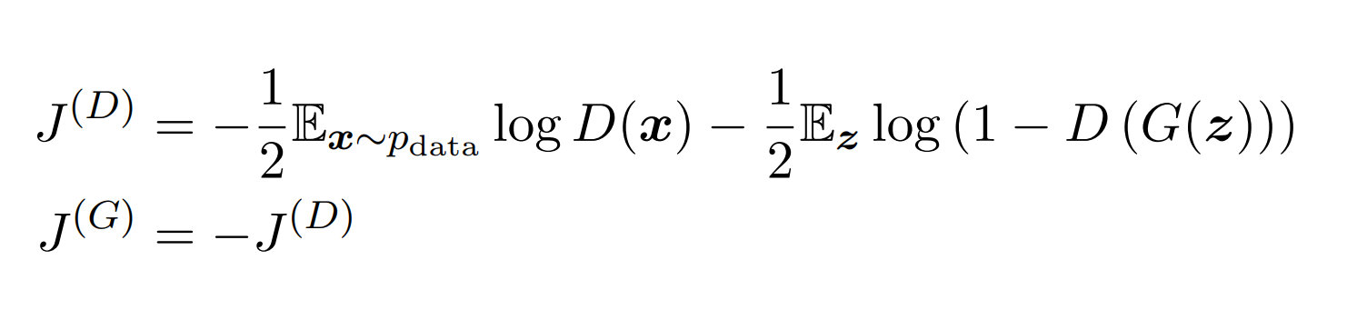
Minimax game

Slide 14
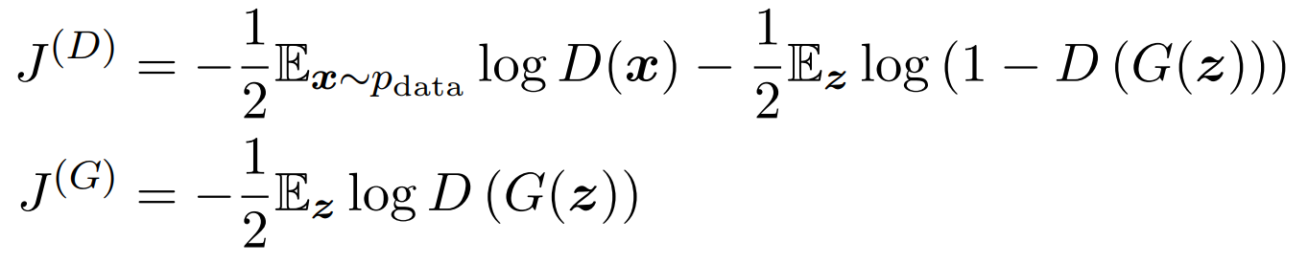
nonsaturating game

Slide 15
4 - Theoretical results

Slide 16
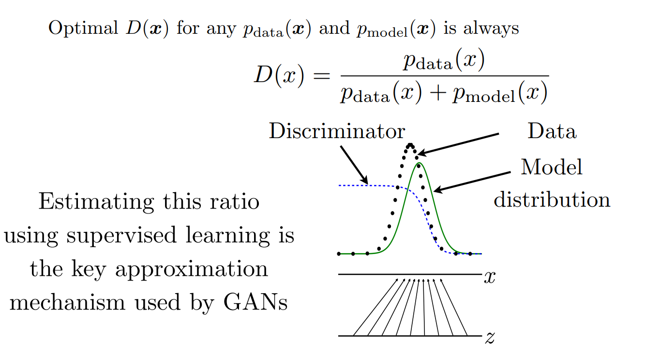
Discriminator strategy

Slide 17
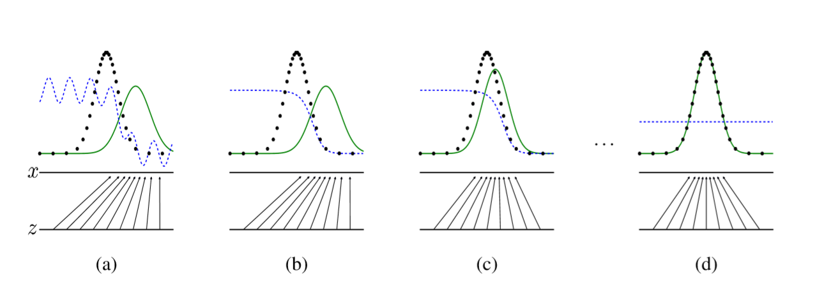
Generative adversarial nets are trained by simultaneously updating the discriminative distribution so that it discriminates between samples from the data generating distribution from those of the generative distribution
Notes:
Generative adversarial nets are trained by simultaneously updating the discriminative distribution (D, blue, dashed line) so that it discriminates between samples from the data generating distribution (black, dotted line) px from those of the generative distribution pg (G) (green, solid line).

Slide 18
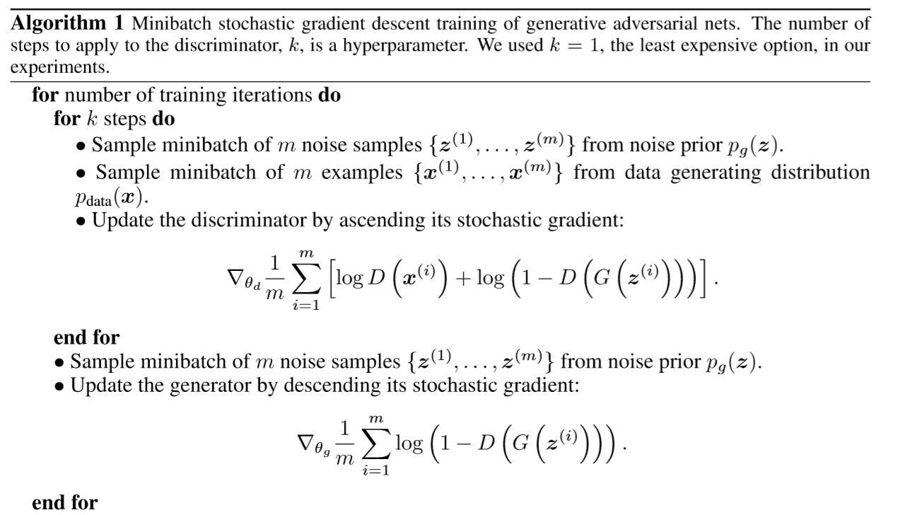

Slide 19
5 - experiments

Slide 20
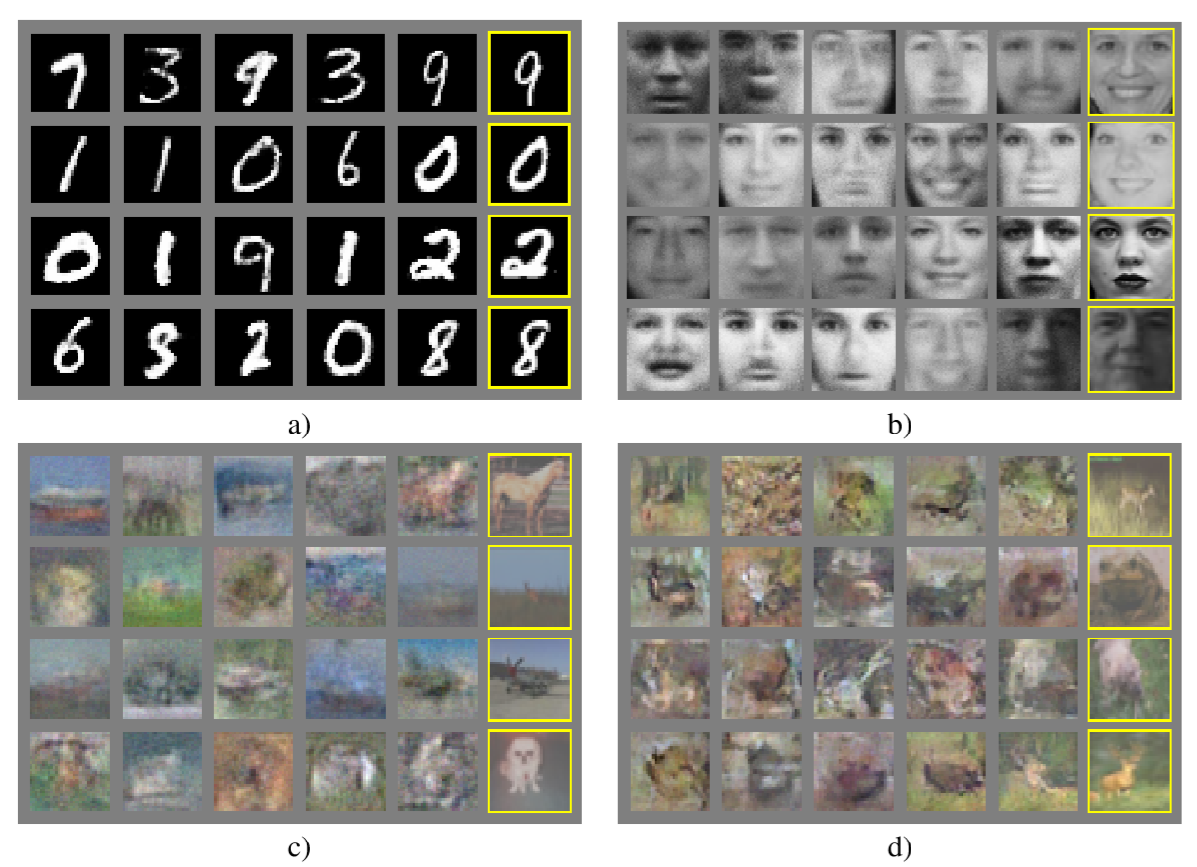
Notes:
Visualization of samples from the model. Rightmost column shows the nearest training example of the neighboring sample, in order to demonstrate that the model has not memorized the training set. Samples are fair random draws, not cherry-picked. Unlike most other visualizations of deep generative models, these images show actual samples from the model distributions,not conditional means given samples of hidden units.
Moreover, these samples are uncorrelated because the sampling process does not depend on Markov chain mixing.
MNIST
b) TFD
c) CIFAR-10 (fully connected model)
d) CIFAR-10 (convolutional discriminator and “deconvolutional” generator)

Slide 21
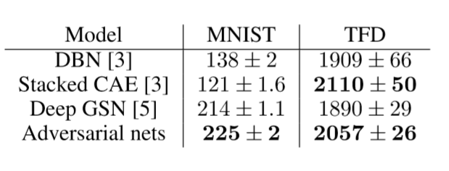
Parzen window-based log-likelihood estimates.
Notes:
The reported numbers on MNIST are the mean loglikelihood of samples on test set, with the standard error of the mean computed across examples.
For MNIST we compare against other models of the real-valued (rather than binary) version of dataset.
On TFD, we computed the standard error across folds of the dataset, with a different σ chosen using the validation set of each fold.
On TFD, σ was cross validated on each fold and mean log-likelihood on each fold were computed

Slide 22
6 - Advantages & disadvantages

Slide 23
ADVANTAGES
DISADVANTAGES
GOOD FOR MOST DISTRIBUTIONS
MARKOV CHAINS ARE NEVER NEEDED
NO INFERENCE NEEDED DURING LEARNING
NOT BEING DIRECTLY UPDATED WITH DATA EXAMPLES, BUT WITH GRADIENTS FROM THE DISCRIMINATOR
NO EXPLICIT REPRESENTATION OF GENERATIVE DISTRIBUTION
HELVETIC SCENARIO

Slide 24
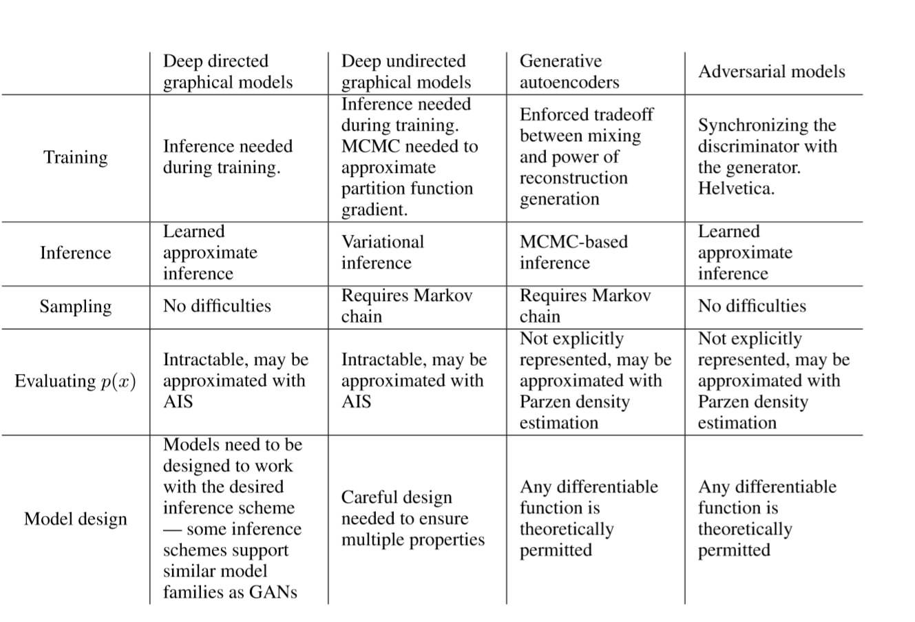
Notes:
Challengesingenerativemodeling: asummaryofthedifﬁcultiesencounteredbydifferentapproaches to deep generative modeling for each of the major operations involving a model

Slide 25
7 - Conclusions & future work

Slide 26
A conditional generative mode
Learned approximate inference
Use adversarial nets to implement a stochastic extension of the deterministic
Semi-supervised learning
Efﬁciency improvements
Notes:
A conditional generative model p(x | c) can be obtained by adding c as input to both G and D.
2. Learned approximate inference can be performed by training an auxiliary network to predict z given x. This is similar to the inference net trained by the wake-sleep algorithm [15] but with the advantage that the inference net may be trained for a fixed generator net after the generator net has finished training.
One can approximately model all conditionals p(xS | x6S) where S is a subset of the indices of x by training a family of conditional models that share parameters. Essentially, one can use adversarial nets to implement a stochastic extension of the deterministic MP-DBM [10].
4. Semi-supervised learning: features from the discriminator or inference net could improve performance of classifiers when limited labeled data is available.
5. Efficiency improvements: training could be accelerated greatly by devising better methods for coordinating G and D or determining better distributions to sample z from during training.

Slide 27

Thank You!

